Slide 1
CIT 3152
Data communication and Computer Networks Concepts
cit 3152

Slide 2
Introduction
Data Communication: The process of transferring information between two places in a form, which can be handled by data communications equipment.
Today, data communications is often referred to as computer communication because computers, or computer peripheral devices such as a printer or VDU terminal, are usually involved.
  Modern data/computer communications, which use the computer which in turn, uses telecommunications - the telephone, cable, satellite etc.
cit 3152

Slide 3
CONCEPTS
Data Communications
Is the movement of computer information from one point to another by means of electrical or optical transmission systems (called networks).
Telecommunications
Is the transmission of voice, video, data, which imply longer distances
cit 3152

Slide 4
CONCEPTS
A communication channel refers to the medium used to convey information from a sender (or transmitter) to a receiver, and it can use fully or partially the medium
Data transmission is the transfer of data from point-to-point often represented as an electromagnetic signal over a physical point-to-point or point-to-multipoint communication channel
cit 3152

Slide 5
Computer data
Familiar forms of information carried by data communication are:
  Text: Alphabetic characters
  Numeric data: Information in the form of numbers,
  Graphical data: In the form of pictures or diagram that can be sent by fax machines or computers.
  Sound:
  Video: Pictures accompanied by sound.
  Multimedia: A mixture of the different forms of information.
cit 3152

Slide 6
CONCEPTS
Session: communication dialog between network users or applications
Network: interconnected group of computers and communication devices
Node: a network-attached computer
Link: connects adjacent nodes
Path: end-to-end route within a network
Circuit: the conduit over which data travels
Packetizing: dividing messages into fixed-length packets prior to transmission over a network’s communication media
Routing: determining a message’s path from sending to receiving nodes.
cit 3152

Slide 7
Elements of a communication system
In order to communicate, there must be two entities,
  One to send the information.
  One to receive it.
Computer communication involves the following elements
  Communication Equipment (hardware)
  Communication software
  Protocols
cit 3152

Slide 8
Communication Hardware
Can be classified into the following
  Data Terminal Equipment (DTE): Sources or destinations of information. Comprises of communications equipment such as terminals, host computer, printer etc.
  Data Circuit Terminating Equipment (DCE): Made up of interface devices such as the modem, switches, routers etc.
  Data communications channels: Paths through which information travels. Can be Electrical, Optical or Electromagnetic based.
cit 3152

Slide 9
Communication software and Protocols
Communications software
  Accomplishes two critical functions.
    Control of the connection.
    Sending and receiving data.
Protocols
  These are standards, which allow the entities to communicate with each other.
  Protocols are therefore a set of rules precisely defining the methods used to communicate.
cit 3152

Slide 10
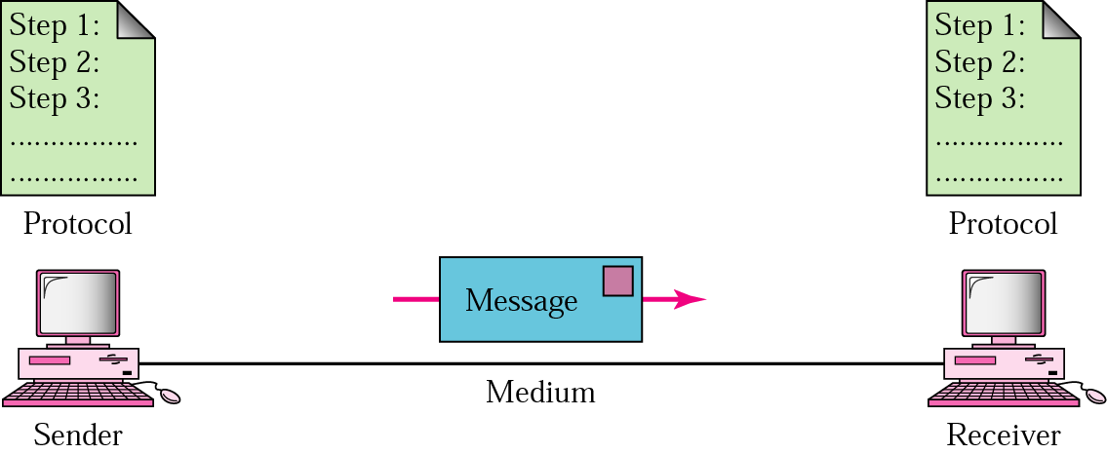
The communication system
A sketch of the complete communication system appears as shown below
DTE
DCE
Medium
DCE
DTE
Source
Interface
Source
Destination
cit 3152

Slide 11
Standard codes
The useful way to transmit data between digital equipment is by two-state electrical signals (0 and 1)
  For successful communication, both communicating devices must interpret codes in the same way – done by using a common code.
The most widely accepted code for alphanumeric characters is the ASCII (American Standard Code for Information Interchange).
ASCII uses 7 bit codes to represent alphanumeric characters.
  But 8 bits are normally transmitted with the eighth bit being used as a parity bit for error detection.
cit 3152

Slide 12
Standard codes
ASCII Converts all the characters used to represent information into numerical values, which are then converted to bits and finally signals.
IBM mainframe and peripheral equipment use EBCDIC (Extended Binary Coded Decimal Interchange Code).
  It uses all eight bits to define characters.
Digital conversions also need to be made for graphics, sounds, video and multimedia.
This digitized information is transmitted using serial or parallel transmission modes.
cit 3152

Slide 13
Transmission methods - Parallel Transmission
Parallel transmission
  Each bit is sent over separate connections all the same time.
  It is the method employed within computers to interconnect components such as memory and the central processing unit.
  Tracks on a printed circuit board that constitute a parallel path for data transmission are referred to as a bus.
cit 3152

Slide 14
Transmission Modes/A Taxonomy of Transmission Modes
We use the term transmission mode to refer to the manner in which data is sent over the underlying medium
Transmission modes can be divided into two fundamental categories:
Serial — one bit is sent at a time
  Parallel — multiple bits are sent at the same time
cit 3152

Slide 15
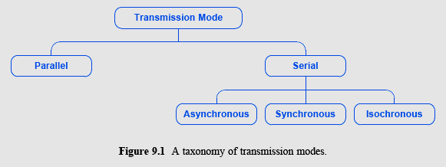
A Taxonomy of Transmission Modes
cit 3152

Slide 16
PARALLEL MODE
  Parallel transmission allows transfers of multiple data bits at the same time over separate media-Each bit uses a separate wire
In general, parallel transmission is used with a wired medium that uses multiple, independent wires
Furthermore, the signals on all wires are synchronized so that a bit travels across each of the wires at precisely the same time
cit 3152

Slide 17
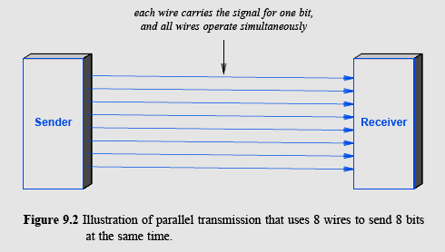
Parallel transmission
  To transfer data on a parallel link, a separate line is used as a clock signal. This serves to inform the receiver when data is available. In addition, another line may be used by the receiver to inform the sender that the data has been used, and its ready for the next data.
cit 3152

Slide 18
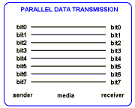
Parallel
cit 3152

Slide 19
Transmission methods - Parallel Transmission
Advantages
  High speed: It is very fast
  it can send N bits at the same time
    a parallel interface can operate N times faster than an equivalent serial interface
  Match to underlying hardware: Internally, computer and communication hardware uses parallel circuitry
    a parallel interface matches the internal hardware well
cit 3152

Slide 20
Disadvantages
  Devices operate at different speeds. E.g. the computer, which is electronic, is much faster than the printer is, which is electro-mechanical; it sends thousands in the time it takes a printer to print 1 character.
  The size and complexity of the cabling required.
  The cost - Power and material
cit 3152

Slide 21
Transmission Modes - Serial Transmission
It involves sending each bit of a data byte along a single connection (signal wire and ground), in sequence, bit by bit.
  Each bit is sent over a single wire, one after the other
  Usually no signal lines are used to convey clock (timing information)
Sender and receiver must contain a hardware that converts data from the parallel form used in the device to the serial form used on the wire
cit 3152

Slide 22
serial
The parallel data used by source terminal equipment must be converted to serial form by a shift register before it can be transmitted.
Another shift register converts the serial data back to parallel form
cit 3152

Slide 23
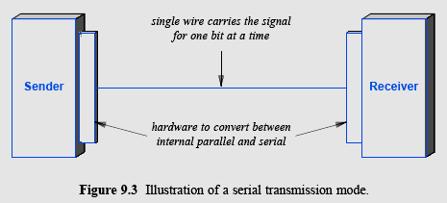
Serial Transmission
cit 3152

Slide 24
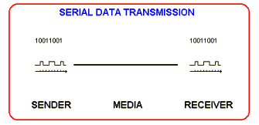
SERIAL
cit 3152

Slide 25
Transmission Modes - Serial Transmission
Advantages
  Cheap- serial networks can be extended over long distances at much less cost
  Simple and easy to implement (less complex)-using only one physical wire means that there is never a timing problem caused by one wire being slightly longer than another
Disadvantages
  Slower speed due to extra processes of parallel to serial and back.
  Extra information sent for control purposes.
cit 3152

Slide 26
Timing of serial transmision
Serial transmission mechanisms can be divided into three broad categories (depending on how transmissions are spaced in time):
Asynchronous transmission can occur at any time
  with an arbitrary delay between the transmission of two data items
Synchronous transmission occurs continuously
  with no gap between the transmission of two data items
  Isochronous transmission occurs at regular intervals
  with a fixed gap between the transmission of two data items
cit 3152

Slide 27
Asynchronous Transmission
It is asynchronous if the system allows the physical medium to be idle for an arbitrary time between two transmissions
The asynchronous style of communication is well-suited to applications that generate data at random
  (e.g., a user typing on a keyboard or a user that clicks on a link)
cit 3152

Slide 28
serial
The disadvantage of asynchrony arises from the lack of coordination between sender and receiver
  While the medium is idle, a receiver cannot know how long the medium will remain idle before more data arrives
Asynchronous technologies usually arrange for a sender to transmit a few extra bits before each data item
  to inform the receiver that a data transfer is starting
  extra bits allow the receiver to synchronize with the incoming signal
  the extra bits are known as a preamble or start bits
cit 3152

Slide 29
Synchronous Transmission
Synchronous mechanism transmits bits of data continually
  with no idle time between bits
  after transmitting the final bit of one data byte, the sender transmits a bit of the next data byte
  each character is sent without start or stop bits
The sender and receiver constantly remain synchronized
  which means less synchronization overhead
cit 3152

Slide 30
Isochronous Transmission
Isochronous transmission
  is designed to provide steady bit flow for multimedia applications
Delivering such data at a steady rate is essential
  because variations in delay known as jitter can disrupt reception (cause pops or clicks in audio/make video freeze for a short time)
Isochronous network is designed to accept and send data at a fixed rate
cit 3152

Slide 31
Degradation of signals
The data signal will be degraded during long distance communication owing to imperfections of the transmission medium used.
This is by being
  Attenuated: Get smaller
  Distorted: Misshapen
  Noise: Picking up noise along the way.
The receiver may be unable to differentiate between 0’s and 1’s.
  More marked when data is transmitted at high speeds.
  Limits the Maximum distance we can send signals.
cit 3152

Slide 32
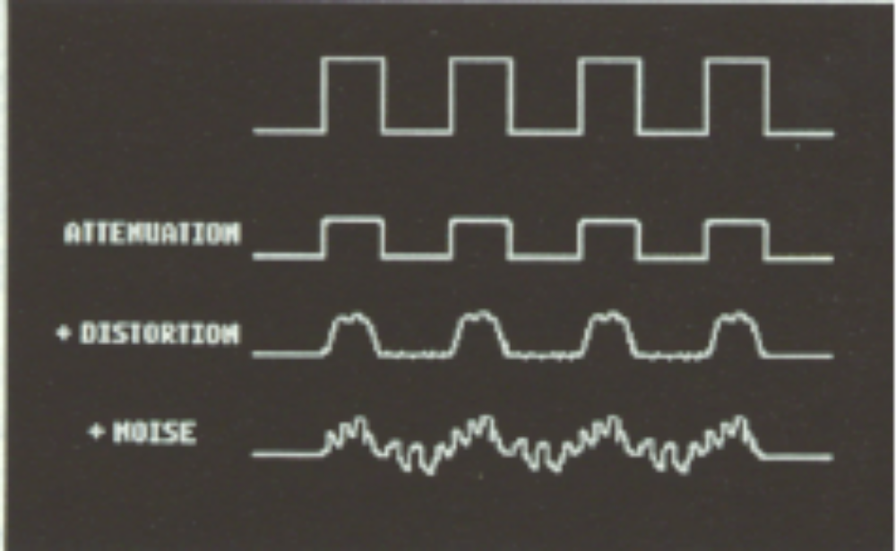
Degradation of signals
cit 3152

